Slide 1
HelloWorld.exe executions
Nov. 18th, 2023

Slide 2
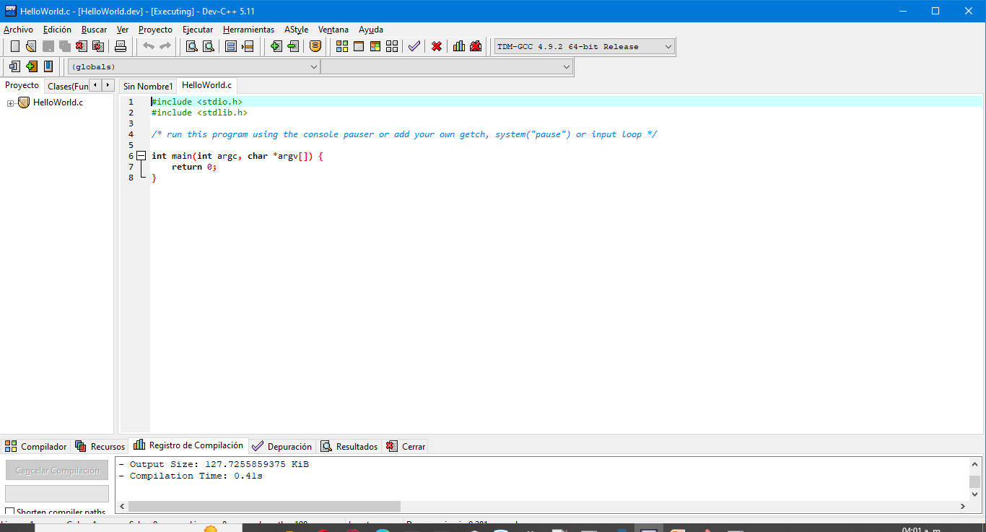
First HelloWorld.c code

Slide 3
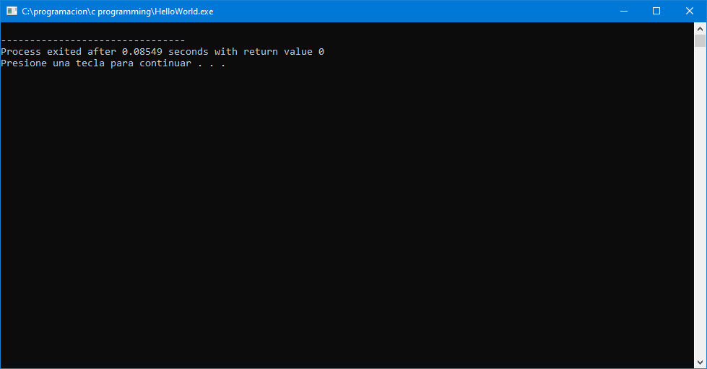
Execution

Slide 4
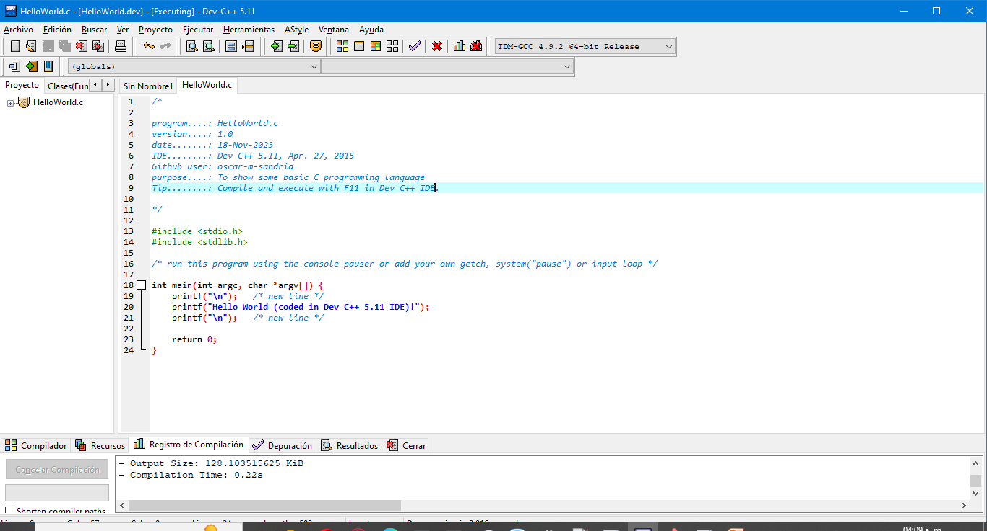
HelloWorld.exe v1.0

Slide 5
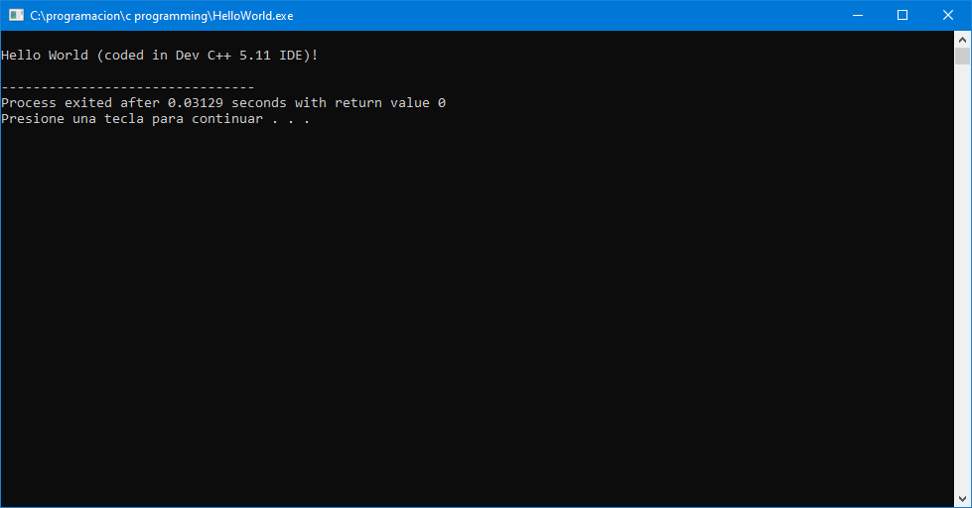
Execution of v1.0

